Slide 1
Universal Charging Friend
U.C.F.
Group A
Alfred Berrios
Tristan Byers
Melanie Cromer
Michael Matthews
Critical Design Review
Fall 2010

Slide 2
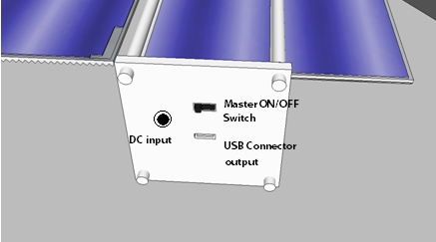
Overview of the Project
The UCF is a portable charging unit which will supply power
from photovoltaic cells, a kinetic generator, and a wall outlet
The power is stored in a 7.2 V battery, and can be used directly to
power any 5 V electronic device through a USB connector

Slide 3

Overview
An LCD displays the current capacity of the
battery, which power source is charging the
battery, and the battery percent remaining.

Slide 4
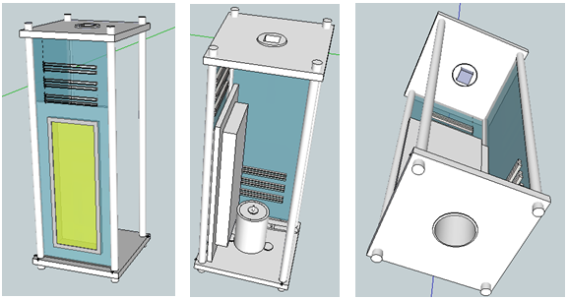
Project Goals and Objectives
Design a system which will store and expend power efficiently
Marketable
  Affordable
  Practical
  Reliable

Slide 5
Specifications & Requirements
Dimensions of the unit:
  19cm x 7.5cm x 7.5cm
Operate at any temperature between -15 and 75 degrees Celsius
Light-weight and easy to carry
Reliably charge USB devices
Consume the minimum amount of power possible to operate

Slide 6
Specifications & Requirements
Contain a DC input connector for the DC wall adapter
Contain a USB connector as a power output to 5 V electronic devices
Contain a button to turn on and off the device
  Button will be able to turn on the backlight
Low battery detection function will automatically shut down the unit to preserve the battery
Wall wart charging circuit will fast charge and then trickle charge the battery
  Will also charge the USB device at the same time

Slide 7
Main Components
Components | Part Type
Solar Panels | 75mm x 75mm 300mA, 0.55V
Kinetic Generator | Motor with gears
Battery | 7.2 V NiMH
Microcontroller | PIC16F690
LCD (16x2 Character) | HD44780 Driver

Slide 8
Power Output Table
 | Typical Voltage (DC) | Maximum Voltage (DC) | Minimum Current | Maximum Current
Solar Panel | 7 V | 8 V | 200 mA | 300 mA
Kinetic Generator | 8.5 V | 11 V | 200 mA | 400 mA
Wall Outlet | 15 V | 15 V | 2500 mA | 2500 mA

Slide 9
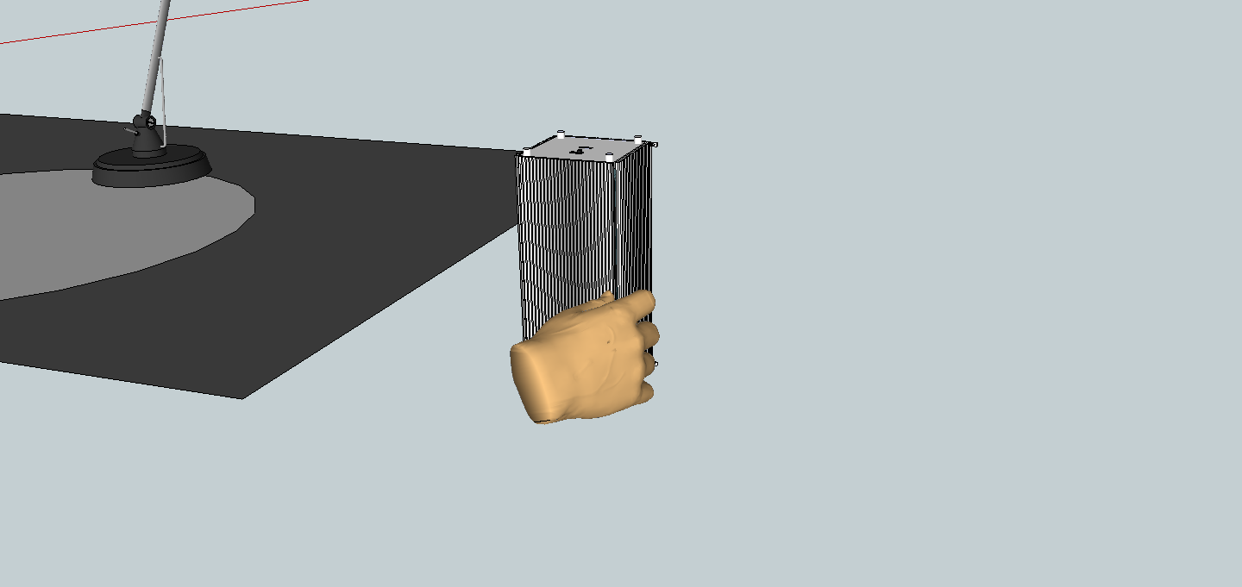
Deployment of Solar Array

Slide 10
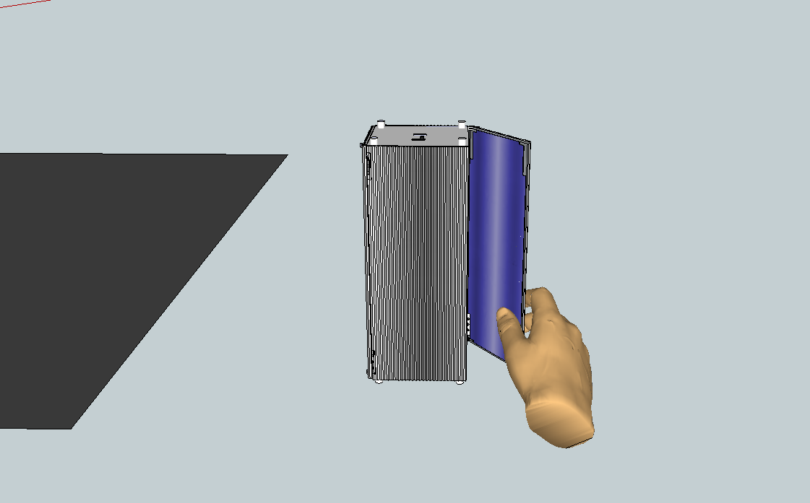
Deployment of Solar Array

Slide 11
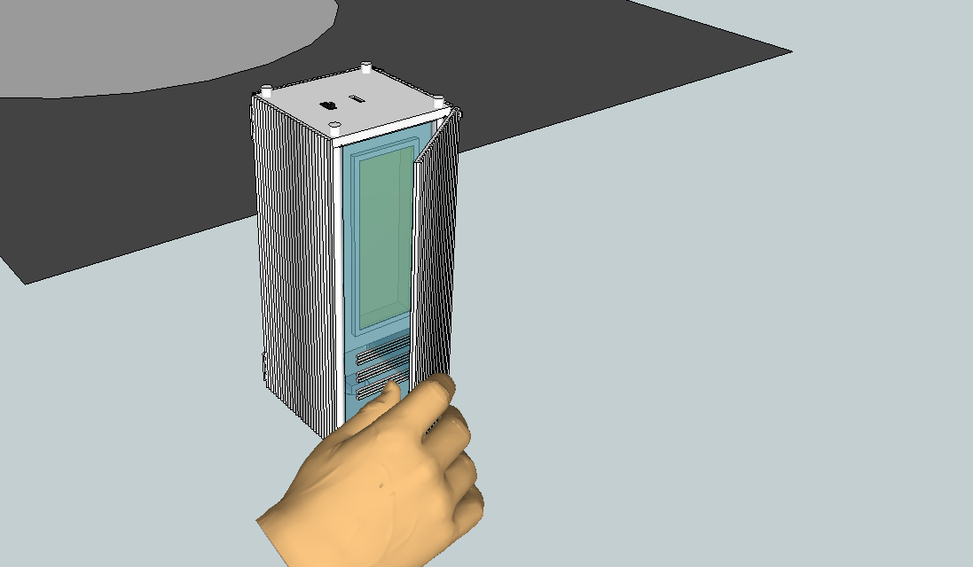
Deployment of Solar Array

Slide 12
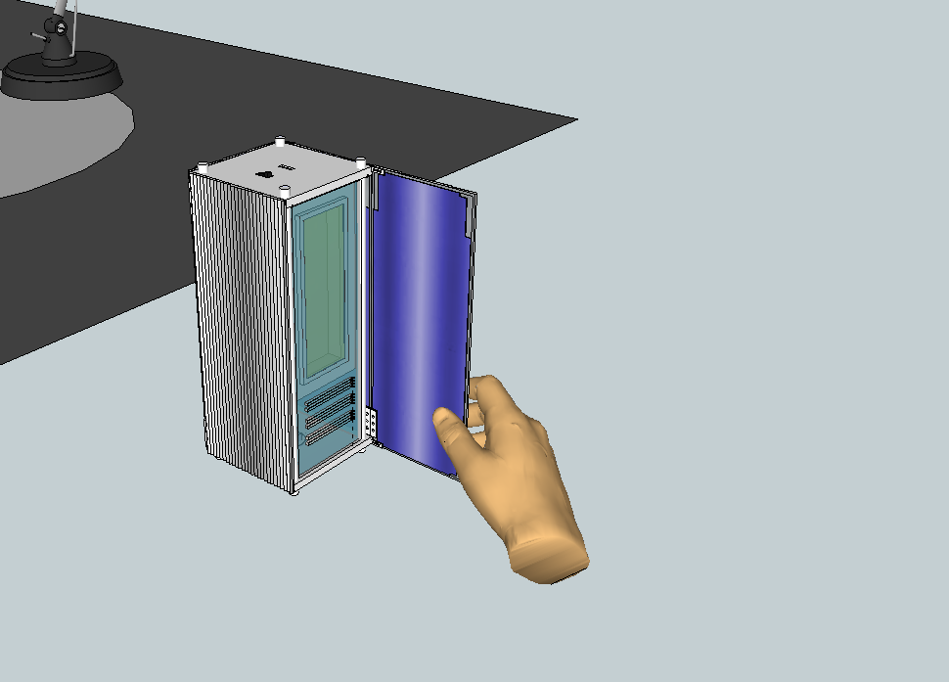
Deployment of Solar Array

Slide 13
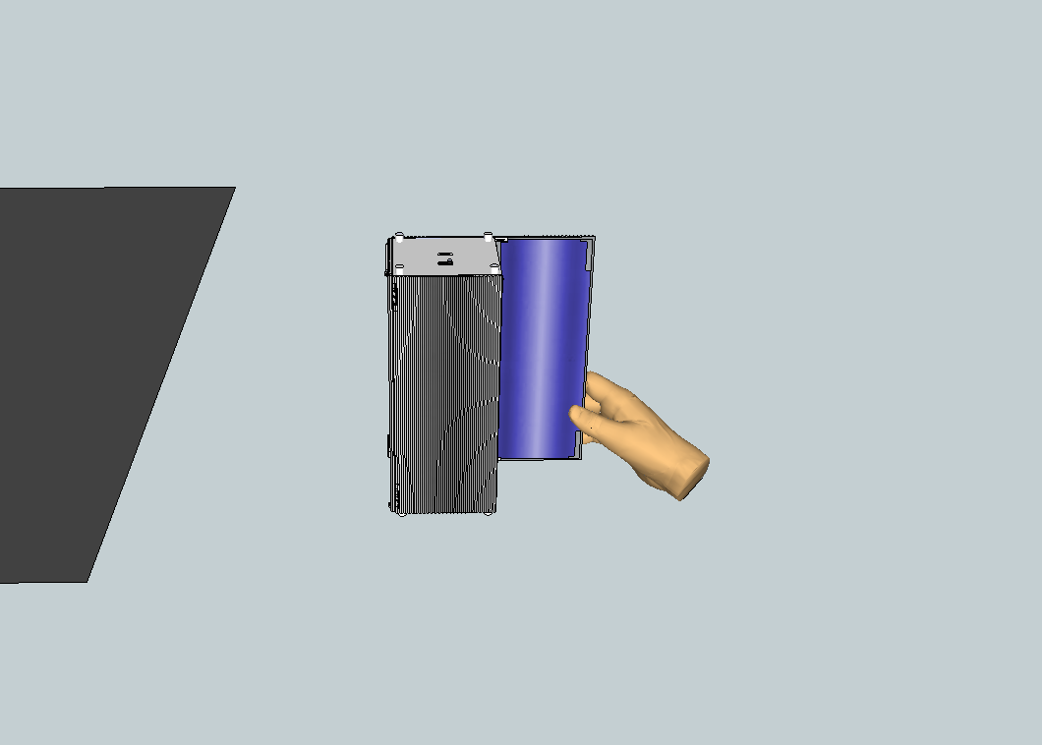
Deployment of Solar Array

Slide 14
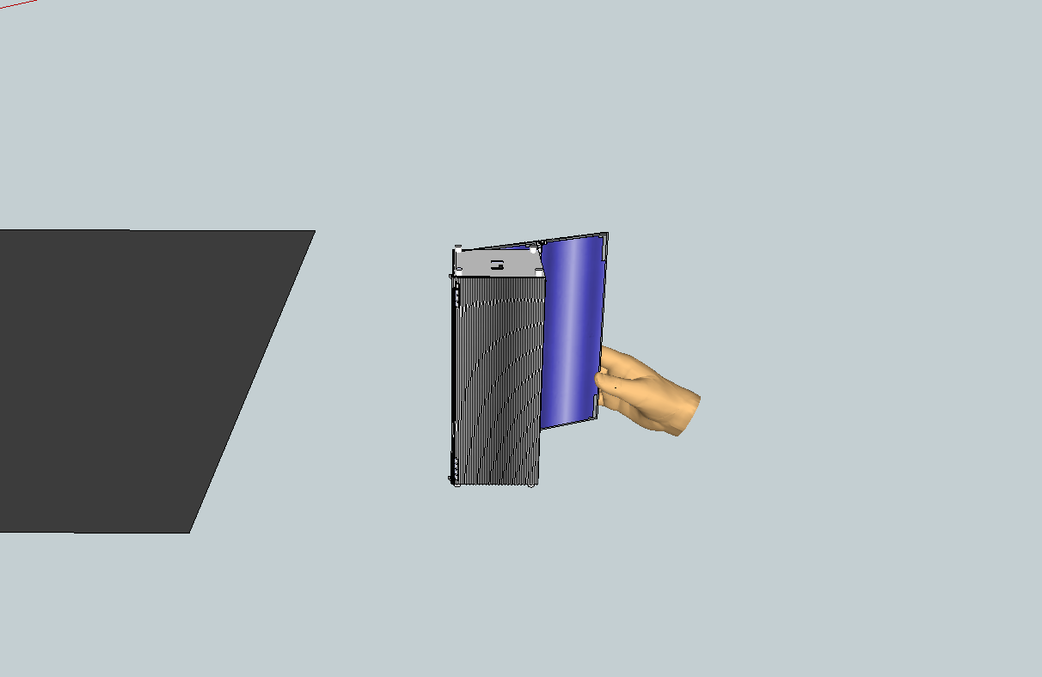
Deployment of Solar Array

Slide 15
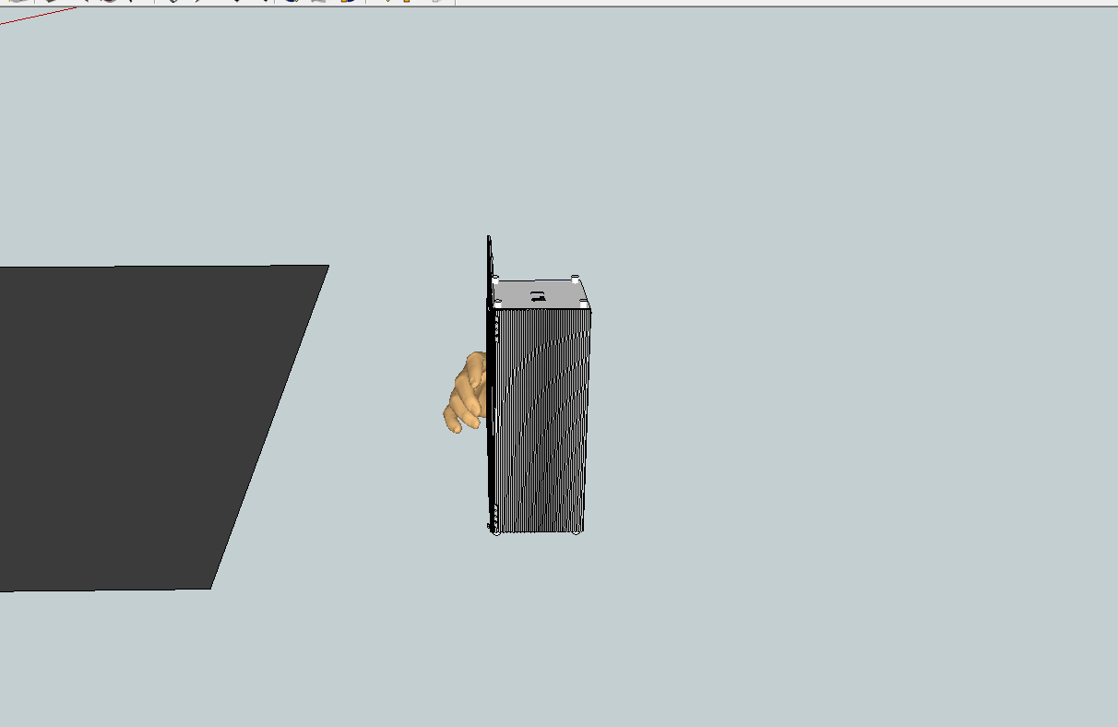
Deployment of Solar Array

Slide 16
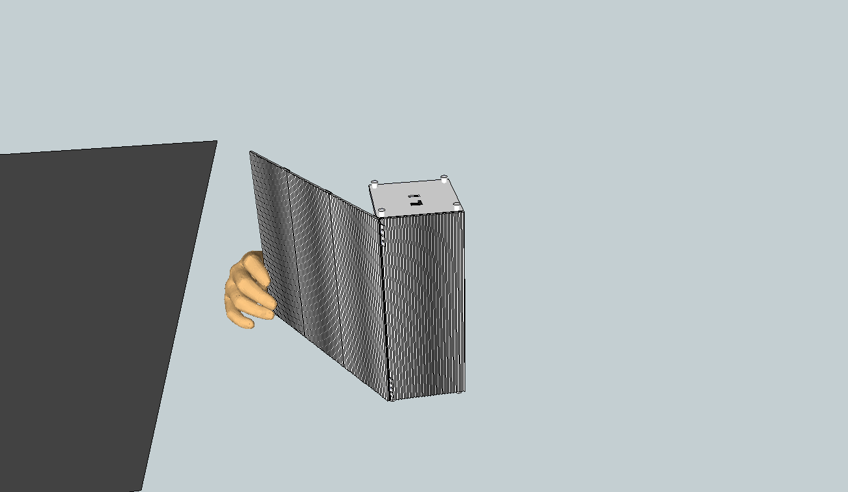
Deployment of Solar Array
Notes:
Here are note to help

Slide 17
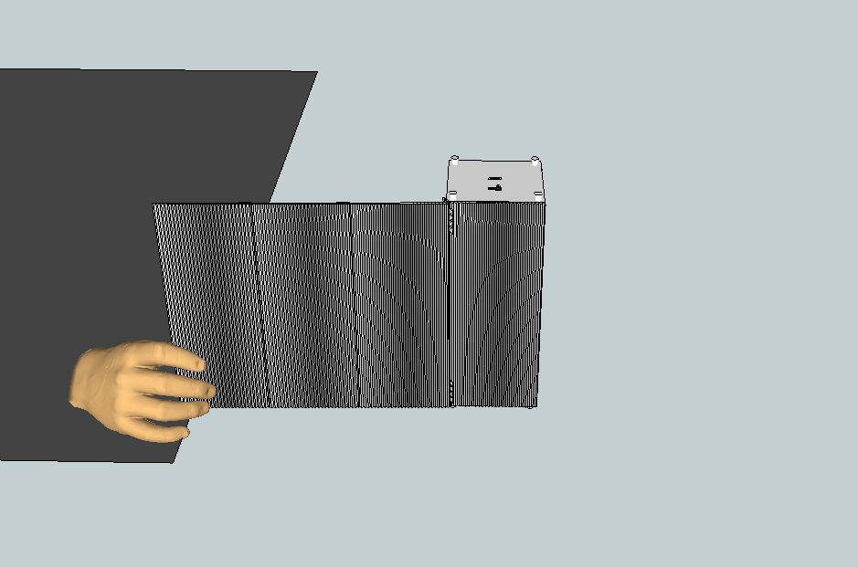
Deployment of Solar Array

Slide 18
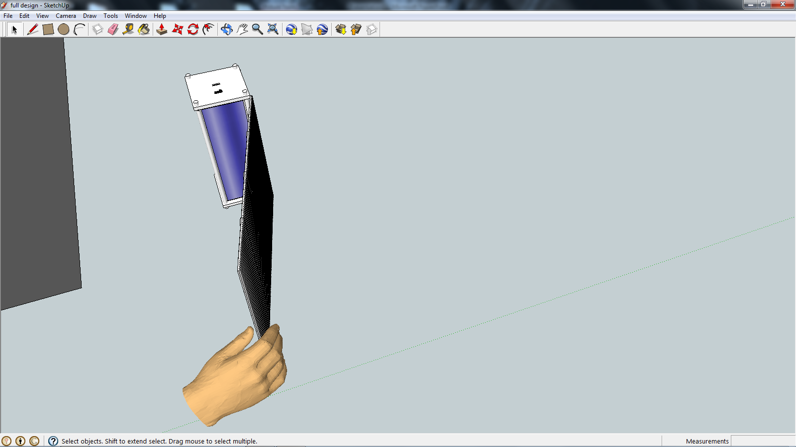
Deployment of Solar Array

Slide 19
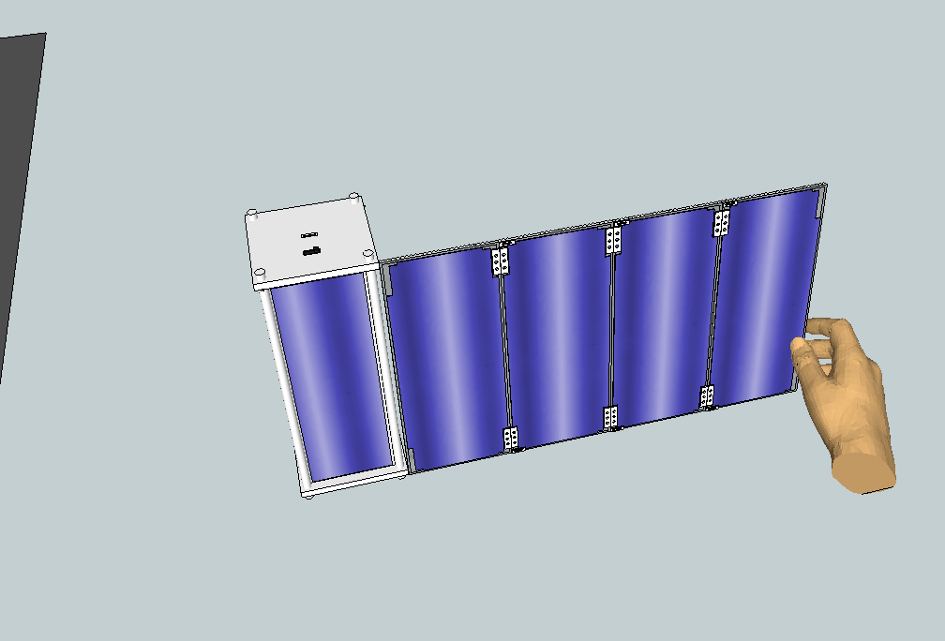
Deployment of Solar Array

Slide 20
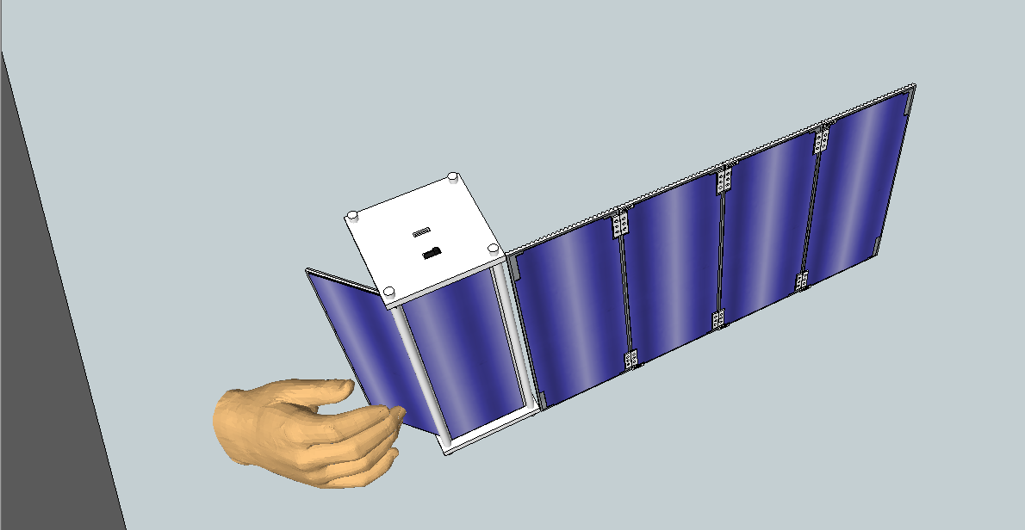
Deployment of Solar Array

Slide 21
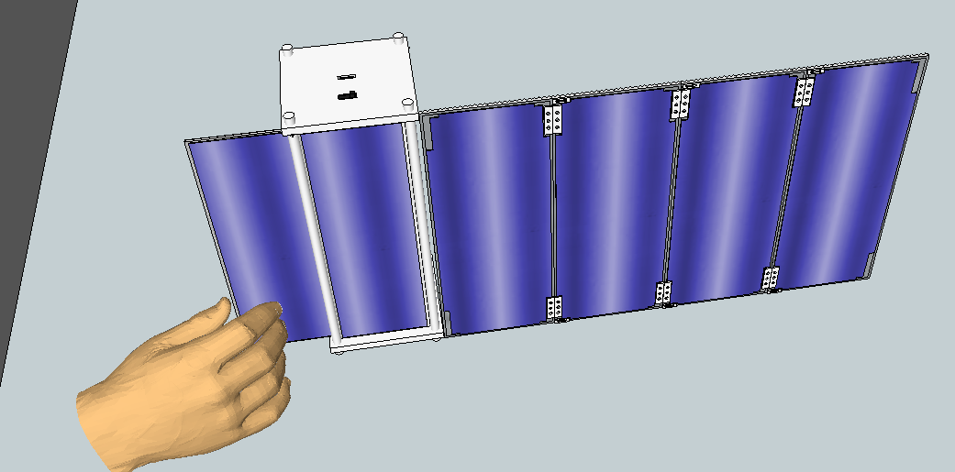
Deployment of Solar Array

Slide 22
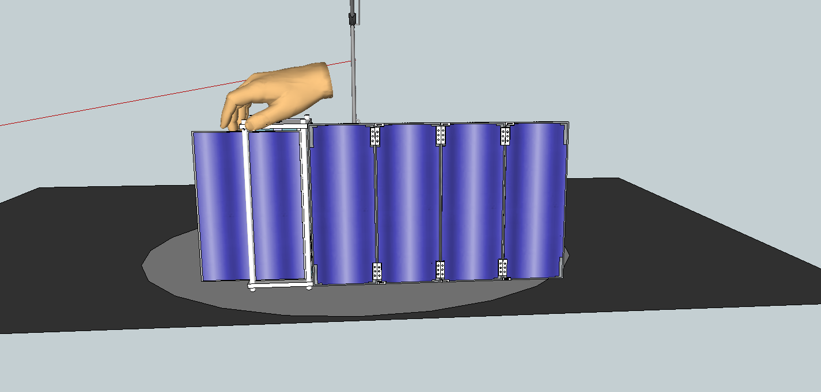
Deployment of Solar Array

Slide 23
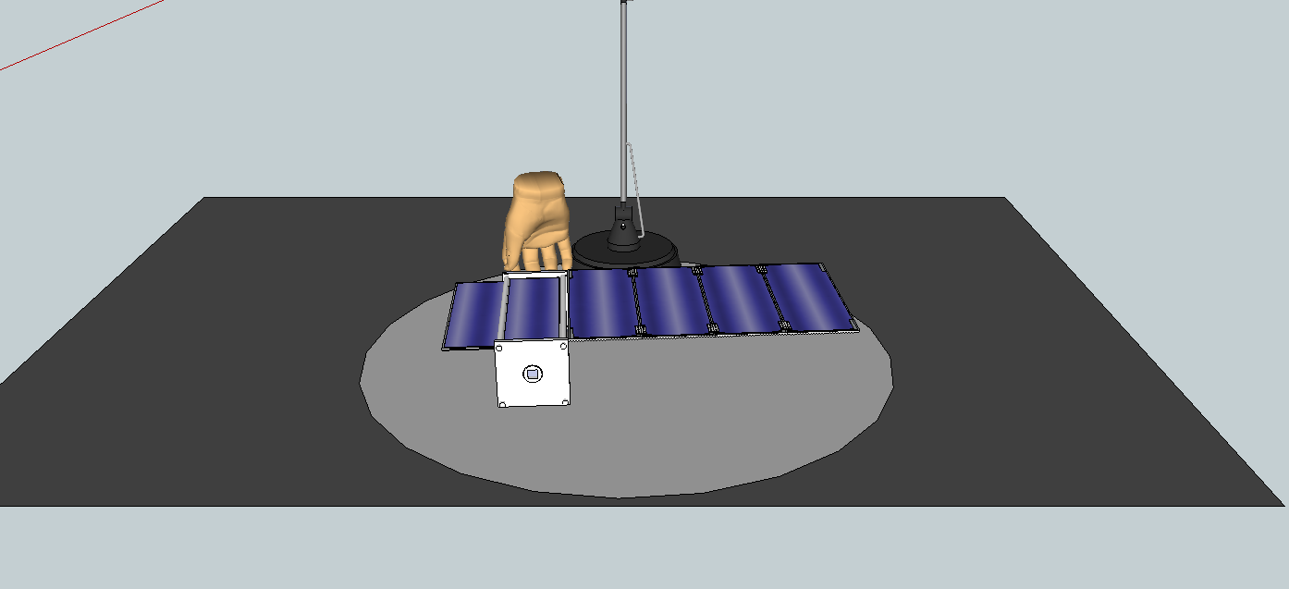
Deployment of Solar Array

Slide 24
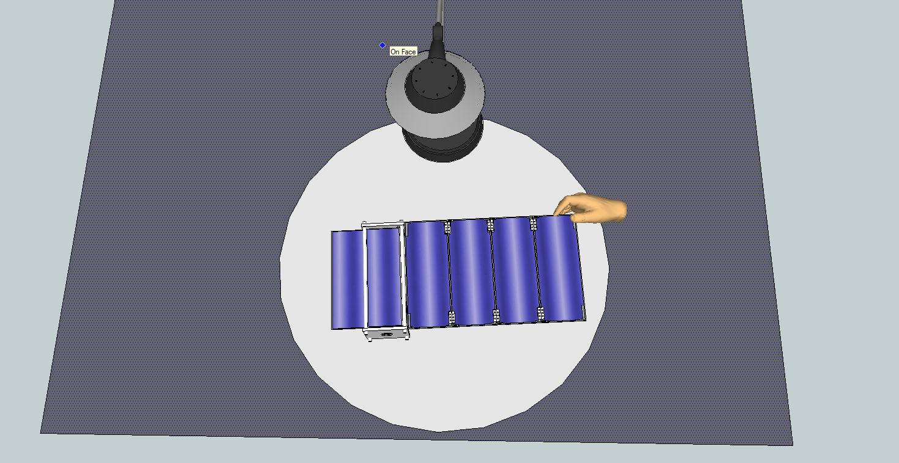
Deployment of Solar Array

Slide 25
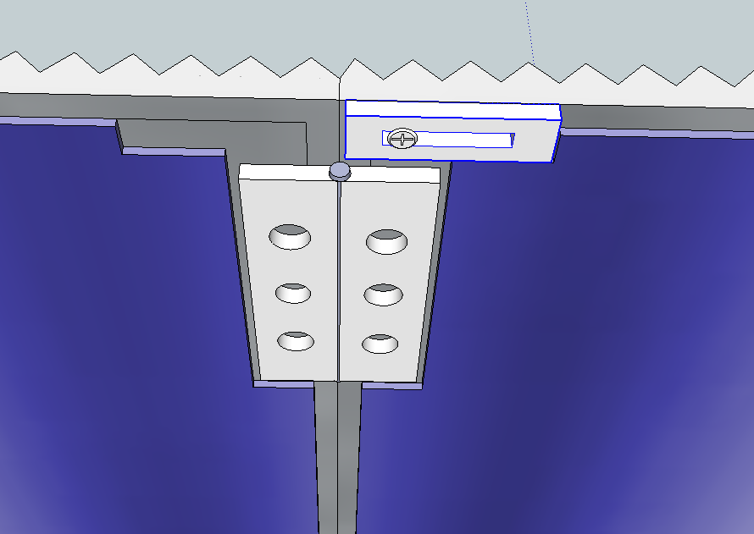
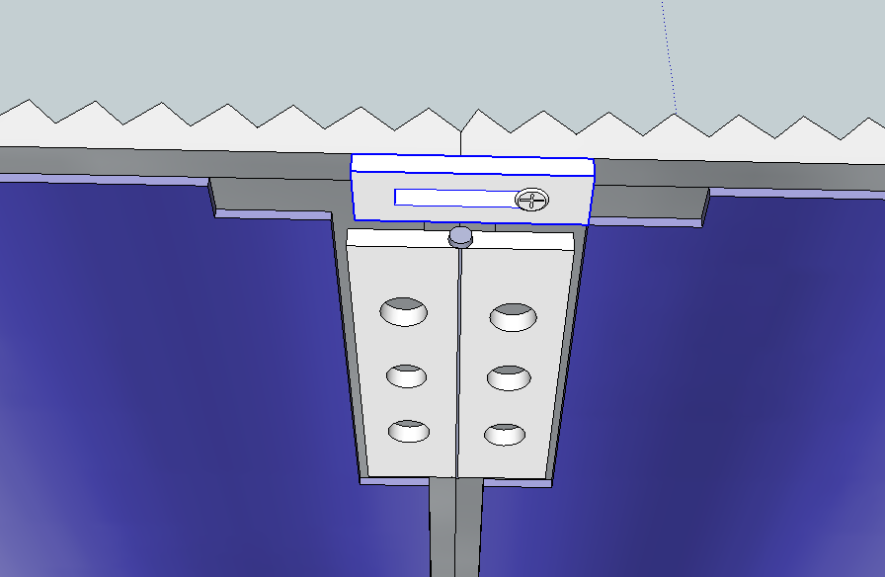
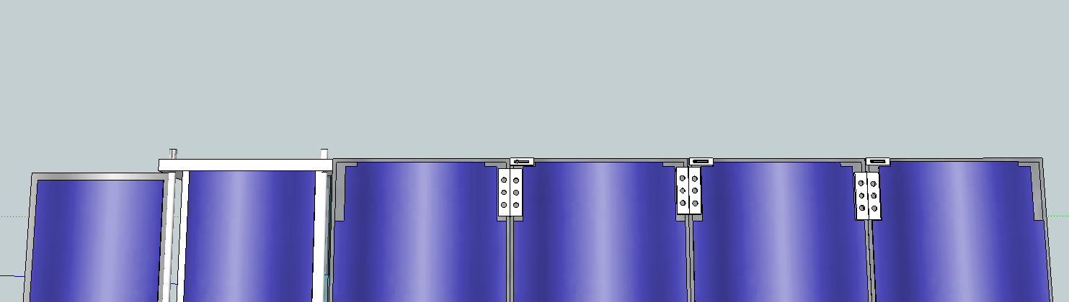
Module Locking Device

Slide 26
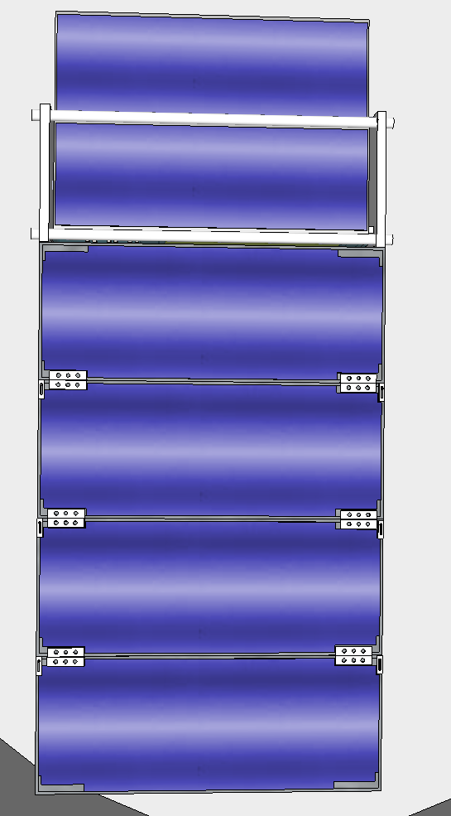
Available Charging Area
Six panels will be available for use as platforms for the Solar Module
Dimensions of the portion of each panel available to support solar cells is 9 in x 3 in

Slide 27
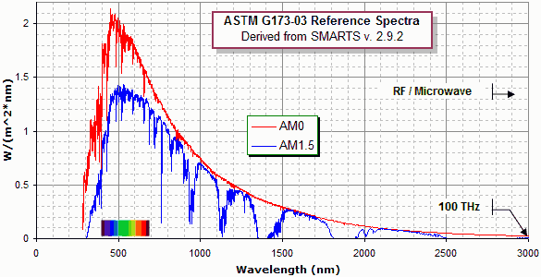
Solar Power Available

Slide 28
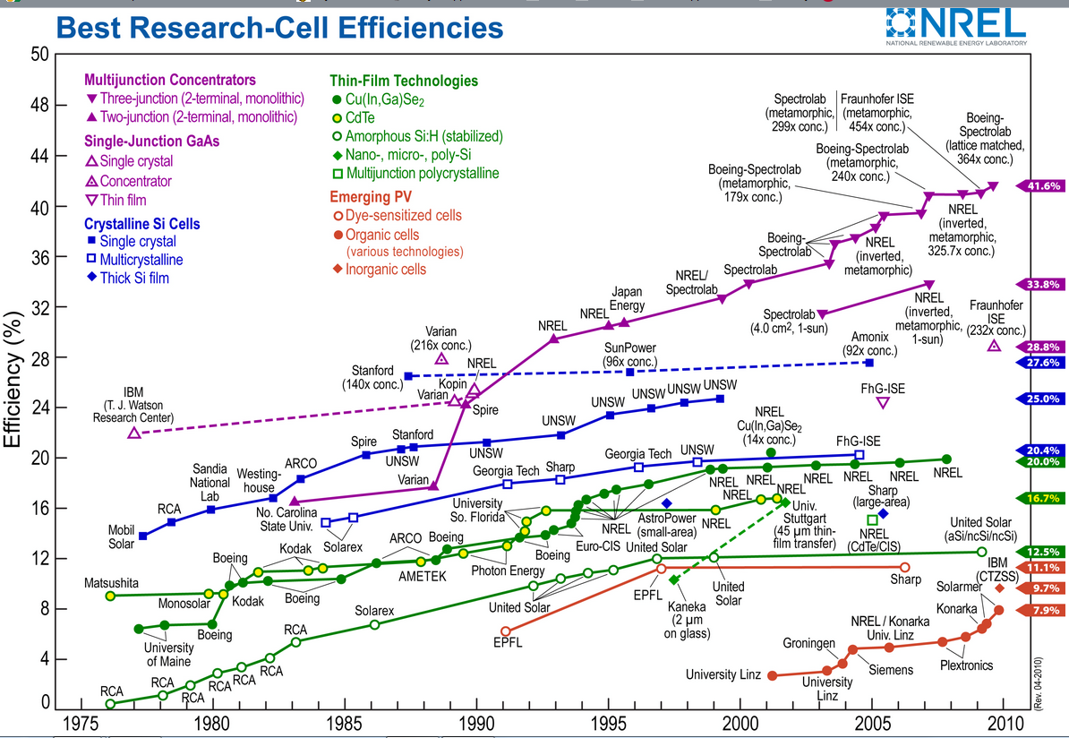

Slide 29
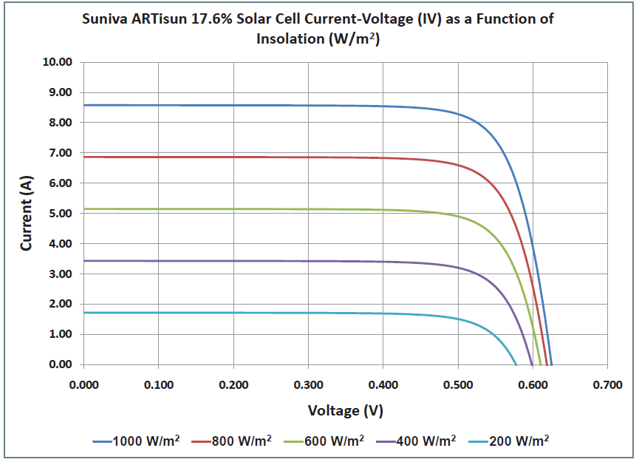
Solar Cell Output

Slide 30
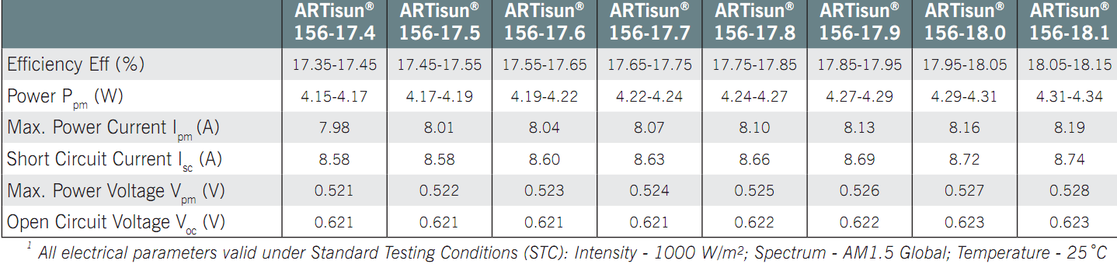
Solar Cell Choices

Slide 31
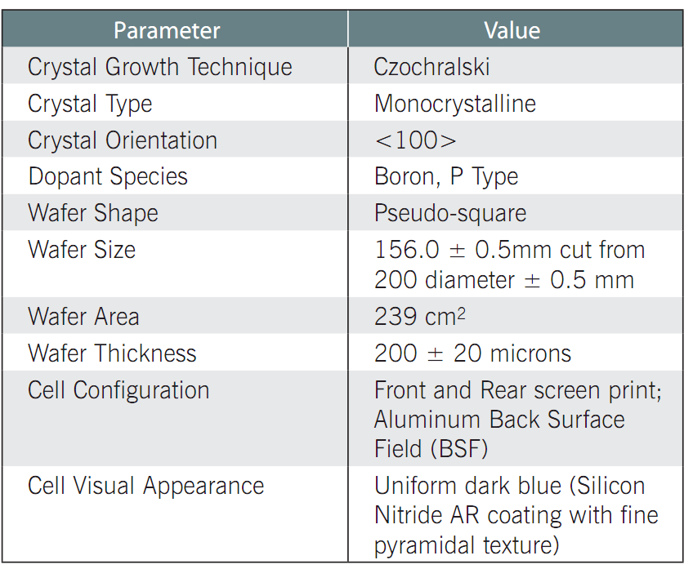
Solar Cell Specifications

Slide 32
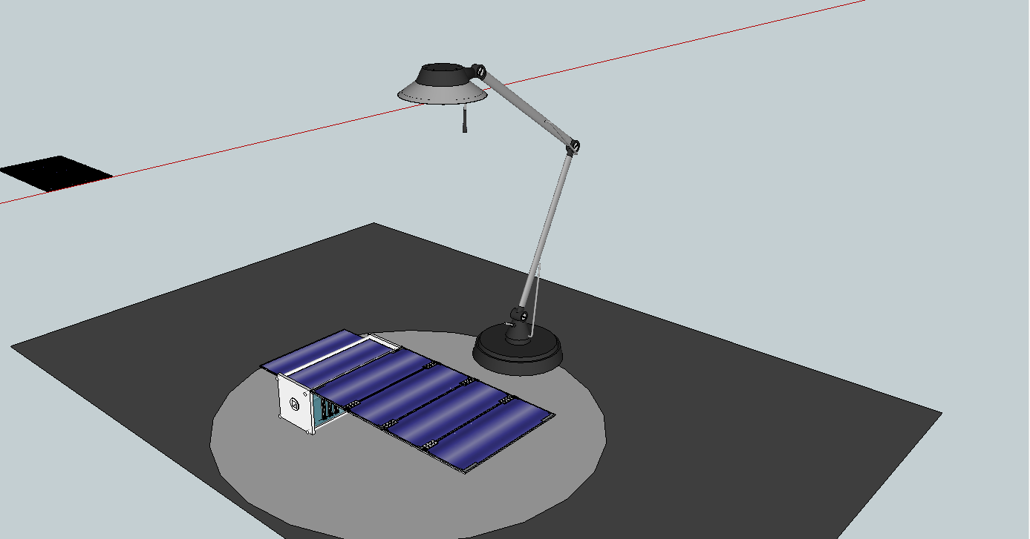
Solar Testing
Expose the solar module to a light source and monitor the output
Test using multiple light sources with different intensities

Slide 33
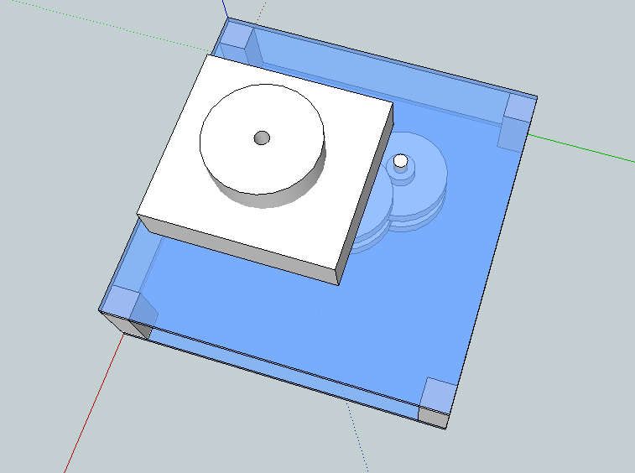
Designing the Kinetic Generator
Requirements:
Compact and light
Substantial power output
Low cost
Reliable and robust

Slide 34
Design Option #1
Harvesting energy from the user’s movement
  Ex: Walking, bicycling, breathing, arm strap
  Pros:
  Huge power potential (50-1000 Watts)
  Cons:
  Efficiently harvesting the potential power is extremely difficult.
  Would be too complicated for the user to set up for use in order to charge the battery (too many external parts)

Slide 35
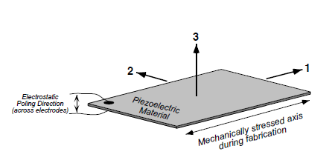
Design Option #2
Piezoelectric Materials:
When the material is strained along an axis, an electric charge is produced.
Ex: placing piezoelectric material inside the sole of a shoe to be compressed by the weight of the user
  Pros:
  New technology, exciting to work with
  Cons:
  Not sufficient enough power could be produced as compared to the alternative kinetic generators

Slide 36
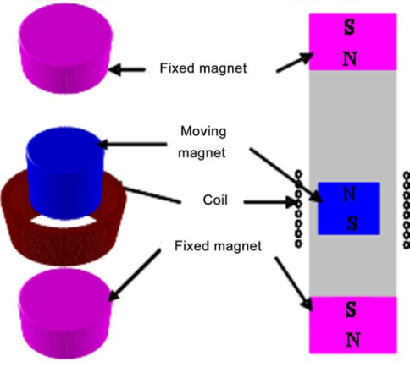
Design Option #3
Electromagnetic generator:
Generating an electric current inside a conductor, which is placed within a magnetic field. Electricity is generated due to the movement of the magnet relative to the coil.
  Pros:
  Cheap to produce
  Robust
  Higher power output
  (compared to possibility
  #1 and #2)

Slide 37
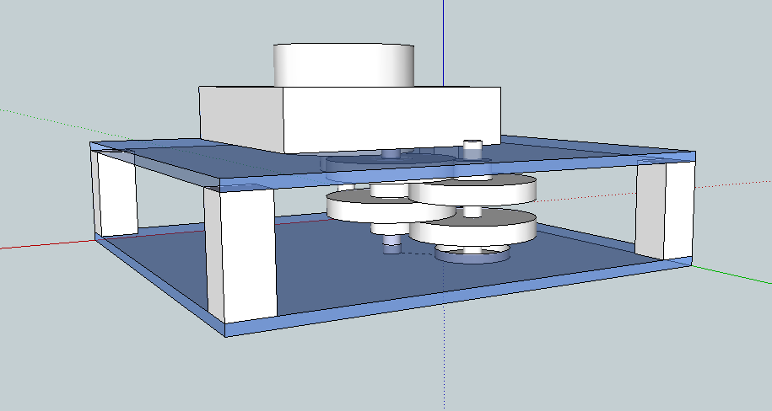
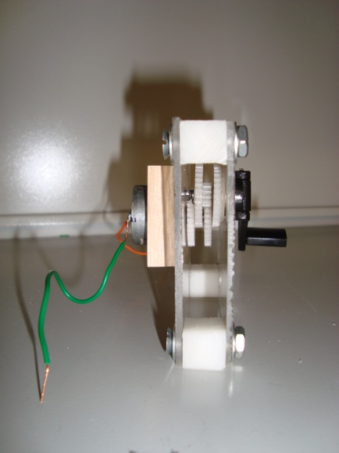
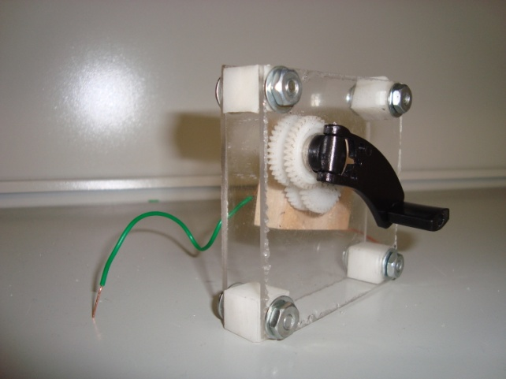
Final Design of Kinetic Generator
Generates 15VAC-25VAC
Generates 5VDC - 10VDC after passing through a full-wave bridge rectifier
Produces 250mA to 400mA
Gear ratio = 12.6

Slide 38
Design Considerations for the Battery
Efficiently charge and discharge the battery pack
Safely charge the battery
USB output for charging devices
Cost-effective design

Slide 39
Determining the best battery for the UCF
Type | Pros | Cons
Lead-Acid | Heavy-duty, least vulnerable to degradation due to multiple cycles | Low energy density, highly toxic, harmful to environment
Nickel-Metal Hydride | Better energy capacity than NiCd, better cycle life than lead acid | High self-discharge, circuit protection
Lithium-ion | High energy capacity, light-weight, better cycle life, faster charge times | Circuit protection needed, expensive, very strict charging procedures, explosive
Notes:
Hello world

Slide 40
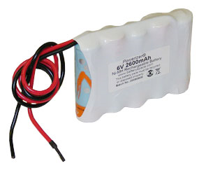
Ni-MH Battery
  7.2V 2.5 Ah
  Voltage: 8.4V ( peak), 7.0V ( min.)
  Dimensions: 72mm (2.8") x 15mm (0.5") x 52mm (2.04")
  $17

Slide 41
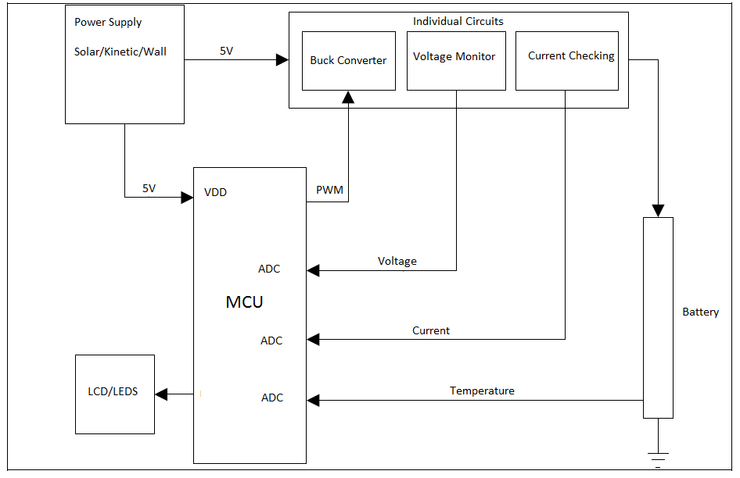
General Schematic for Battery Charger

Slide 42
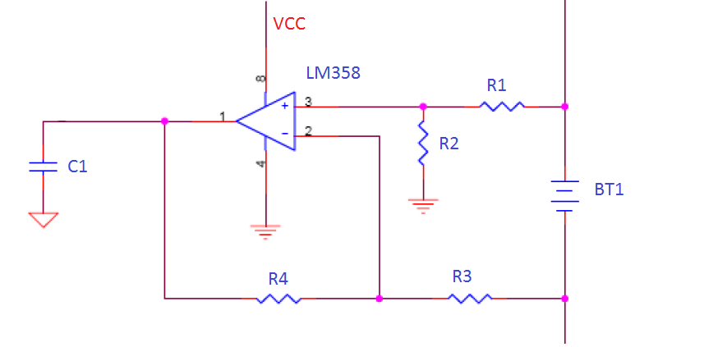
Voltage Measurement
The charging voltage is monitored using an op-amp to measure the voltage difference between the positive and negative pole of the battery.
V_{bat} = (R₂/R₁)*V₊ + V_
Where,
V_{bat}: The output voltage from the op-amp to microcontroller
V₊: The positive pole of the battery
V_: The negative pole of the battery

Slide 43
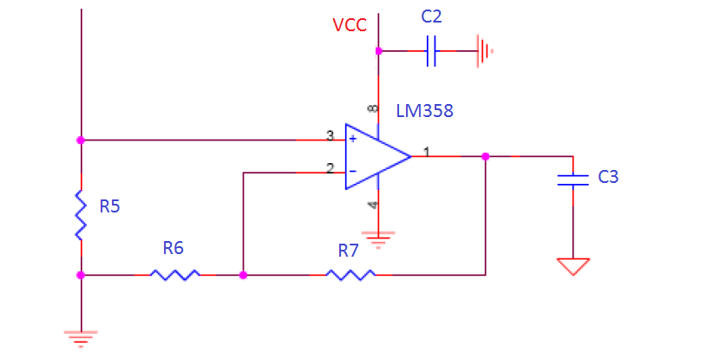
Current Measurement
The charge current is measured by sensing the voltage over a 0.050 ohm shunt-resistor (R₅).
This voltage is amplified using an op-amp to improve the accuracy of the measurement before it is fed into the A/D converter.

Slide 44
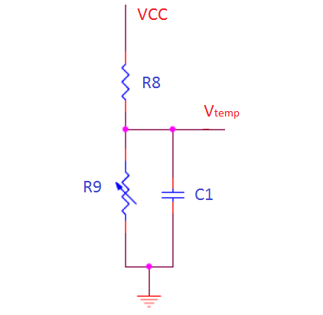
Temperature Measurement
The temperature is measured by a negative temperature coefficient (NTC) resistor.
The NTC resistor is a part of the voltage divider, which is powered by the V_{DD} for the microcontroller.
V_{temp} = V_{DD}× R₉/(R₈+R₉)

Slide 45
Microcontroller: PIC16F690
Single microcontroller is implemented
  Monitor all 3 input voltage sources
  Monitor the battery
  Perform analog-to-digital conversions
  Send data to LCD driver for display
Operates at 220 µA, 2.0 V typical
Standby uses 50 nA, 2.0 V typical
Can operate in ambient temperatures up to 125˚C
Programmed with mikroC compiler using C and the PICKit2 software

Slide 46
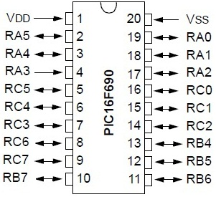
MCU Pinout
20 pins total
  17 pins are I/O pins
  1 pin is input only
12 channels can be used for analog-to-digital conversion
2 comparator pins

Slide 47
MCU Routines
The microcontroller contains functions that perform the following:
  Sample ADC ports and perform conversions
  Send converted values to LCD driver
  Turn off backlight after fifteen seconds
  Read interrupts to turn on backlight
  Press-and-hold detection for power down
  Low battery detection for auto power down

Slide 48
LCD Display Requirements
Low power consumption
Affordable price
Clear and easy to read character display
Sunlight readable (reflective)
Two rows for displaying different values
Backlight for nighttime visibility

Slide 49
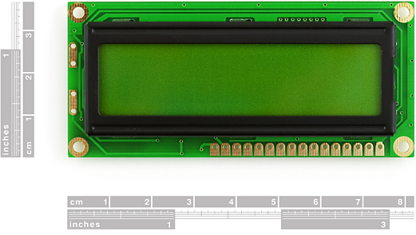
LCD Features
16 characters x 2 lines
Standard HD44780 parallel interface chipset
16 pins (2 pins for backlight)
Backlight

Slide 50
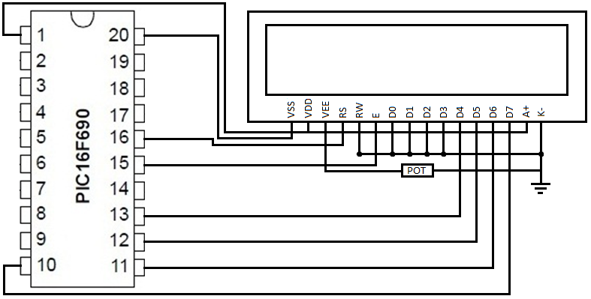
LCD to MCU Connections
Only 6 pins are needed to interface the LCD
Pins D4-D7 are the data pins connection
Enable and register select are the LCD control pins
R/W pin will be grounded since no data will be read from LCD
Pins D0-D3 will be grounded since they are not used in 4-bit mode
4-bit mode will be used because it requires less pins
  Data is sent in nibbles
  Higher nibble is sent first and then the lower nibble is sent

Slide 51
Writing Data and Commands
The following operations will be used in the 4-bit write sequence when sending data or commands to the LCD:
Make sure enable line “E” is low (E = 0)
Set “RS” to 0 for a command or 1 for data/characters
Put the high byte of the data/command on D7-D4
Set “E” high (E = 1)
Delay at least 450 ns
Clear “E” (E = 0)
Delay 5 ms for command writes and 200 us for data writes
Put the low byte of the data/command on D7-D4
Delay at least 450 ns
Clear “E” (E = 0)
Delay 5 ms for command writes and 200 us for data writes

Slide 52
Initialize LCD
Wait 15 ms
Send the first initial value (0x30) as nibble
Wait 5 ms
Send the second initial value (0x30) as nibble
Wait 5 ms
Send the third initial value (0x30) as nibble
Wait 5 ms
Select bus width (0x20 for 4-bit) as nibble
Send byte
Delay 5 ms
C Code
void lcd_init(void)
{
int8 i;
output_low(LCD_RS);
#ifdef USE_LCD_RW
output_low(LCD_RW);
#endif
output_low(LCD_E);
delay_ms(15);
for(i=0 ;i < 3; i++)
{
lcd_send_nibble(0x03);
delay_ms(5);
}
lcd_send_nibble(0x02);
for(i=0; i < sizeof(LCD_INIT_STRING); i++)
{
lcd_send_byte(0, LCD_INIT_STRING[i]);
#ifndef USE_LCD_RW
delay_ms(5);
#endif
}
}

Slide 53
Software Programs
The software used to program the UCF is the mikroC compiler by MikroElektronika. The reason for choosing this compiler is because:
Ease of use
Pre-written library functions
Free
Documentation
Support
The software used to convert the C code to a hex file and program it to the PIC chip is PICKit2 by Microchip.

Slide 54
Software Code
The code for the UCF contains the following functions:
Main
Interrupt
ADC
Shutdown

Slide 55
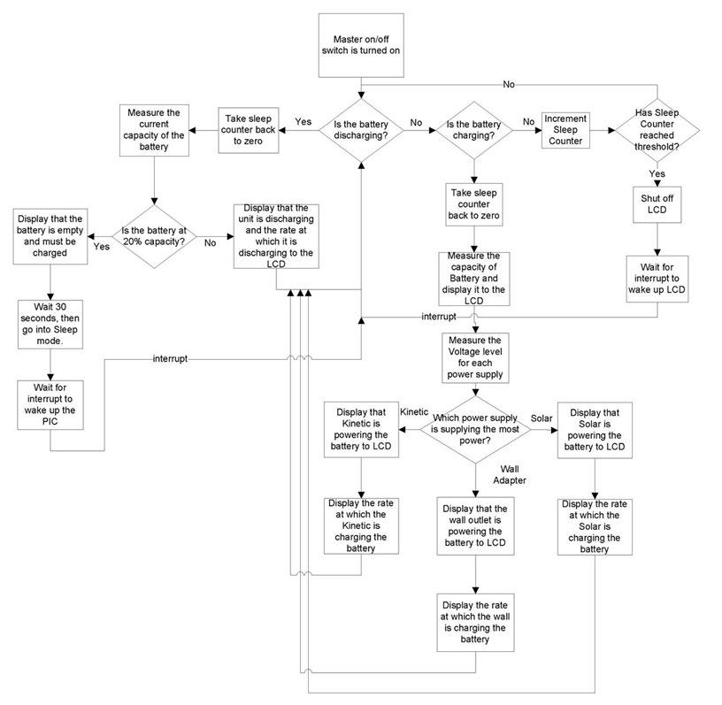

Slide 56
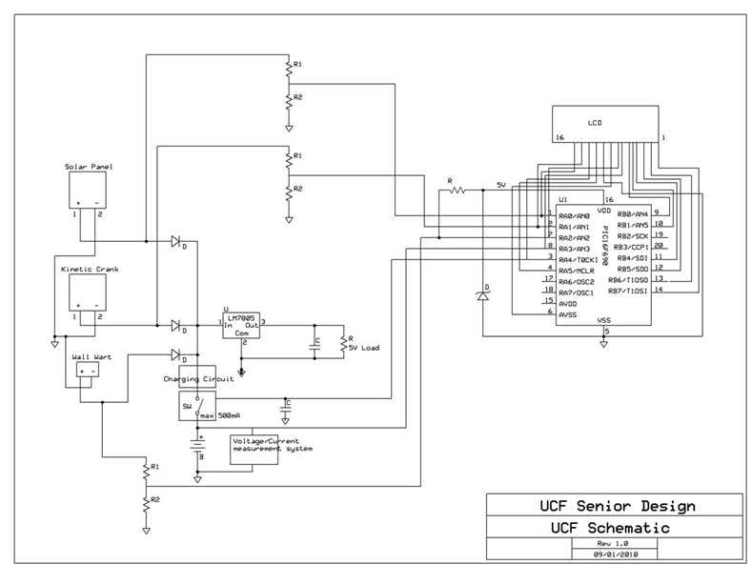
Block Diagram of U.C.F.

Slide 57
Design Changes – 12V Load
12V load was taken out of the design
  Efficiency will be improved
  Most devices use USB ports to charge a device
  Even automobile 12V ports have voltage regulators which bring voltage down to 5V
  Requires less circuit components
    Less money for us to spend, which from a marketing standpoint also means cheaper product for consumers

Slide 58
Design Changes – 12V Load (Cont.)
  Won’t have to design a heat sink
    Heat sink would be required for regulating voltage from 14.8V down to 5V
    Now it’s only necessary to regulate from 6V down to 5V
  Main downside is the project complexity
    Complexity vs. Efficiency

Slide 59
Design Changes - Battery
Battery was changed from 14.8V to 6V
  Kinetic generator would not be able to provide required 16.8V to charge the 14.8V battery
  On a cloudy day, solar panels would not provide enough voltage to charge the battery
  6V battery is less expensive
  Now we can regulate from 6V to 5V using a dc-dc converter efficiently
    Chose a 5V dc-dc converter by muRata which can operate between 4.75V and 28V
    95% efficiency
    Will allow for design flexibility

Slide 60
Design Changes – Battery (Cont.)
New battery is changed from Li-ion to NiMH
  Main reason is because of charging complexity
    NiMH has been recommended by other engineers because it has higher tolerances for charging
  Safety is improved
  Cost is reduced to 1/3 of Li-ion
  Downside of using NiMH over Li-ion is weight
    Negligible for our design

Slide 61
Immediate Plans for Success
Assemble solar module
Display characters on LCD
Test ADC ports with:
  Solar module
  Kinetic generator
  Wall outlet
Assemble charging circuit
Test charging battery with input sources
Design PCB layout and send in to be manufactured

Slide 62
Budget
Items | Required | Acquired | Estimated Cost | Actual Cost (to date)
Kinetic Generator | 1 | 1 | $20 | $10
LCD | 1 | 2 | $10 | $8
Battery and Charger | 1 | 1 | $40 | $50
Solar Cells | 16 | 25 | $100 | $48
MCU | 1 | 1 | $3 | $2
Project Box | 1 | 0 | $50
Tools |  |  | $100 | $60
PCB | 1 | 0 | $50
Parts |  |  | $300 | $20
Miscellaneous |  |  | $50 | $150
TOTAL |  |  | $723 | $348

Slide 63
Current Progress Summary

Slide 64
Questions?

